Slide 1
Styling Quarto from PowerPoint

Slide 2
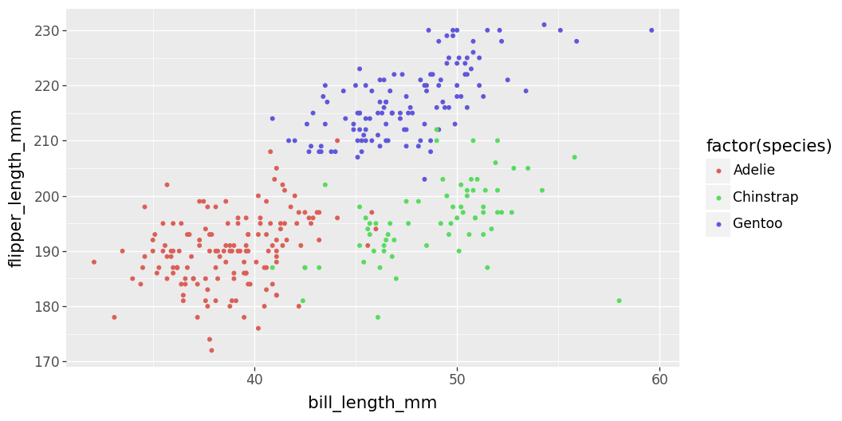
Content with Caption
Did you the new slide templates come from the Slide Master in PowerPoint?
PowerPoint reference docs in Quarto use a small number of specially named slide templates to work.

Slide 3
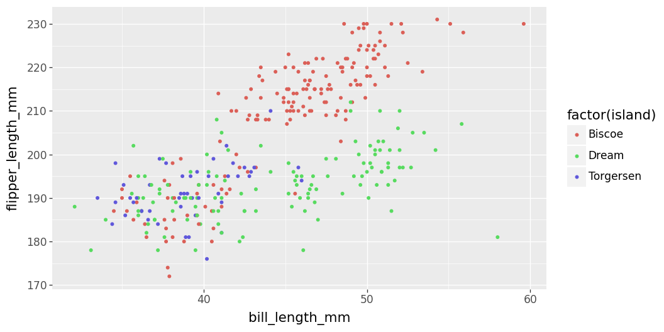
Comparison Layout
This layout is invoked when if either column contains an image (or table).
But. There needs to be text before the image/table (like this) for it to work well.

Slide 4
Just text
If there’s just text on a slide it’ll be formatted with the “title and content” layout.

